Slide 1
TASK ON NEW AI TECHNOLOGIES
AKSHAY T
NSTI CALICUT

Slide 2


Introduction to Next Generation AI Technologies
Next generation AI technologies are revolutionizing industries and transforming how we live and work. These cutting-edge innovations leverage powerful machine learning, deep learning, and natural language processing capabilities to tackle complex problems in novel ways.

Slide 3
Machine Learning Advancements
Supervised Learning
Unsupervised Learning
Reinforcement Learning
Improved algorithms can rapidly analyze vast amounts of labeled data to build predictive models with high accuracy.
Sophisticated techniques discover hidden patterns and extract insights from unlabeled, unstructured data.
AI agents learn optimal strategies by interacting with dynamic environments and receiving feedback on their actions.

Slide 4
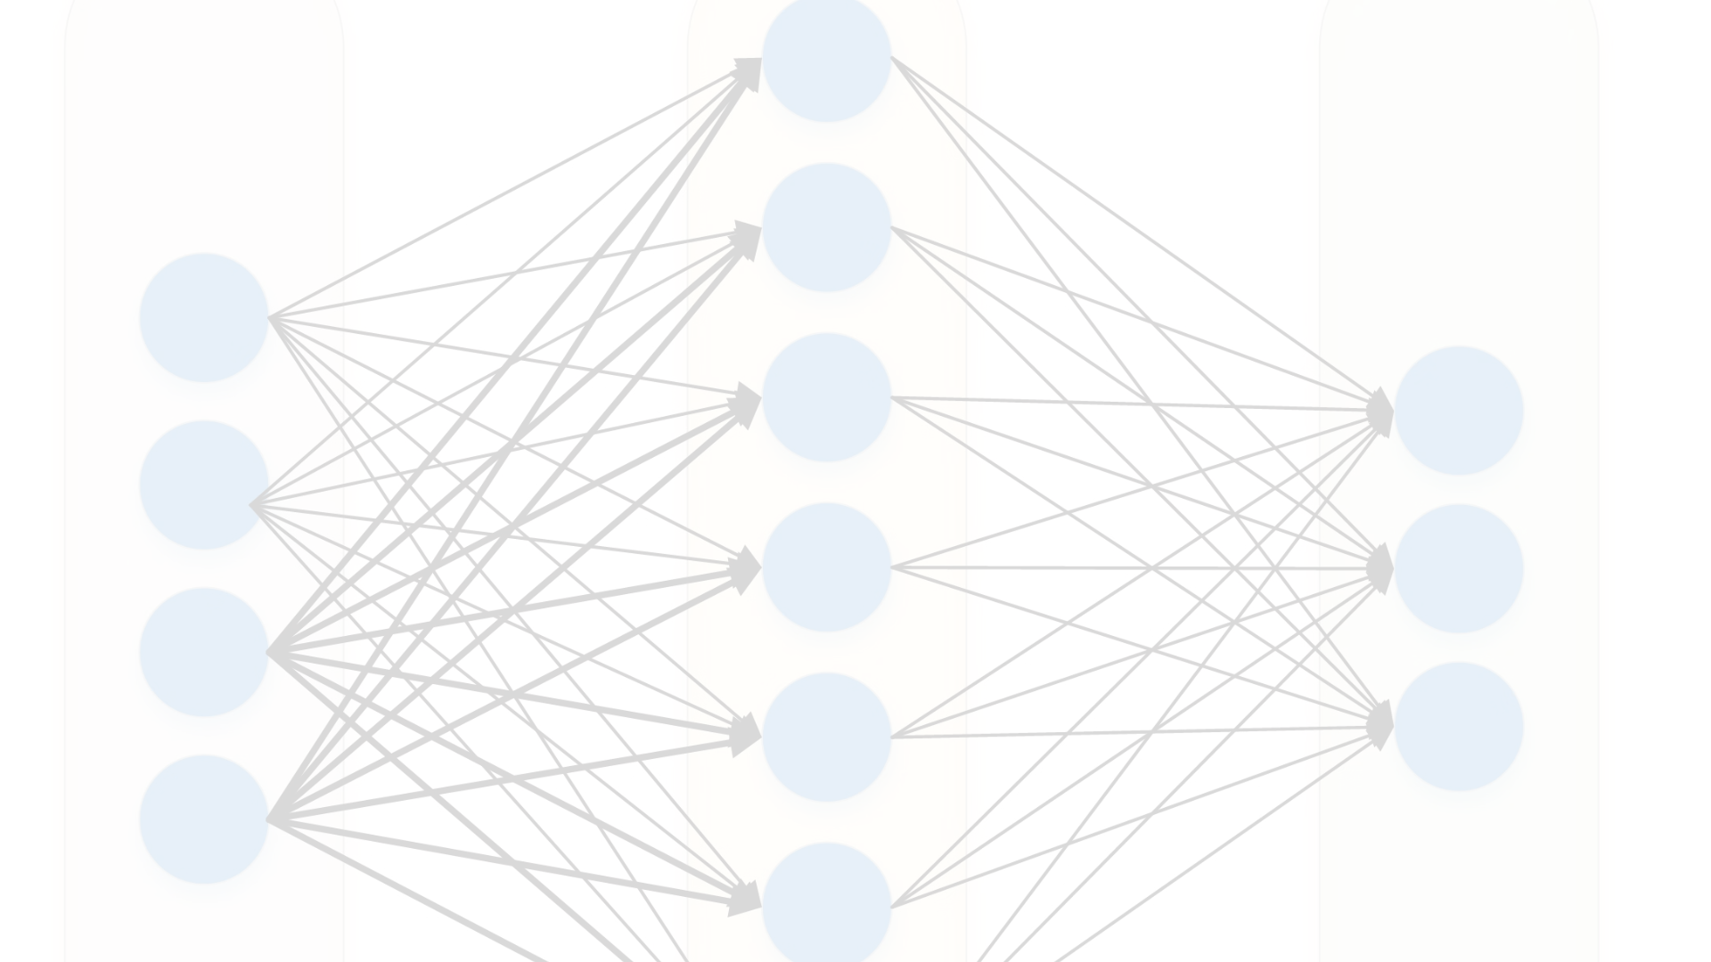
Deep Learning Innovations
Multilayer Neural Nets
Recurrent Networks
Deeper architectures with more hidden layers enable machines to learn complex, abstract representations from data.
These networks process sequential data, like text or speech, maintaining internal states to capture context.
1
2
3
Convolutional Networks
Specialized for processing grid-like data, such as images, these models excel at computer vision tasks.

Slide 5
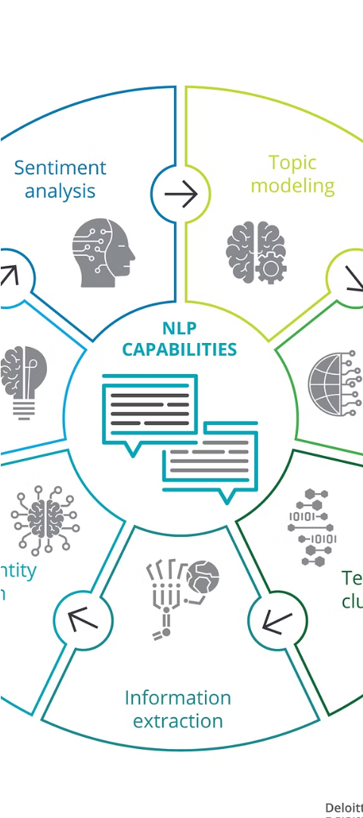
Natural Language Processing Breakthroughs
1
Language Models
2
Machine Translation
Transformer-based models like BERT and GPT-3 demonstrate human-like understanding and generation of natural language.
Neural MT systems now approach human parity in translating between languages with remarkable fluency.
3
Dialogue Systems
Conversational AI assistants can engage in contextual, open-ended dialogues to assist users in natural ways.

Slide 6

Computer Vision Enhancements
Object Detection
Image Segmentation
Algorithms can accurately identify and localize multiple objects within complex scenes in real-time.
Models partition images into semantically meaningful regions, enabling detailed understanding of visual content.
Generative Models
Innovations in GANs allow for the synthesis of highly realistic, novel images from scratch.

Slide 7



Reinforcement Learning Developments
Intelligent Agents
Exploration vs Exploitation
Transfer Learning
RL agents learn to make optimal decisions by interacting with dynamic environments and receiving rewards.
Techniques allow RL models to apply knowledge gained in one domain to perform well in others.
Balancing these two strategies is key for RL agents to discover the best long-term policies.

Slide 8



Ethical Considerations and Societal Impact
Privacy & Security
Safeguarding sensitive data and protecting against misuse of AI systems is crucial.
Algorithmic Bias
Ensuring AI is fair, unbiased, and equitable for all users is an essential challenge.
Transparency & Accountability
Developing interpretable AI models and establishing clear lines of responsibility are vital.

Slide 9
THANK YOU

